Slide 1
Parallel Coordinates plot

Slide 2
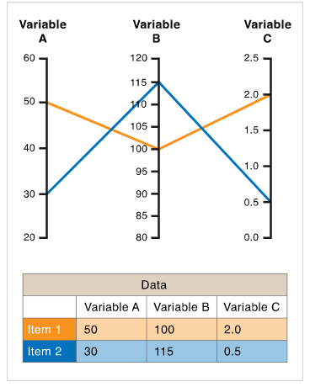
Parallel coordinates is a visualization technique used to plot individual data elements across many dimensions.
Each of the dimensions corresponds to a vertical axis and each data element is displayed as a series of connected points along the dimensions/axes.
Used for plotting multivariate data, comparing many variables together and seeing the relationships between them.

Slide 3
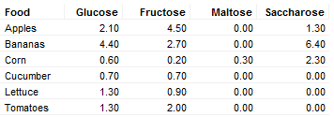
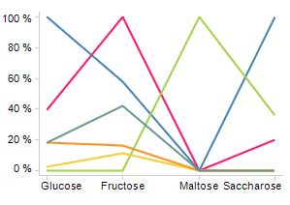

For example, Comparing the amount of different carbohydrates in various fruits and vegetables.

Slide 4
The order the axes are arranged in can impact the way how the reader understands the data.
One reason for this is that the relationships between adjacent variables are easier to perceive, then for non-adjacent variables. So re-ordering the axes can help in discovering patterns or correlations across variables.

Slide 5
Some points to note:
Parallel Coordinates Plots can become over-cluttered and therefore, unreadable when they’re very data-dense.
The order of the axes impacts how the reader understands the data. Relationships between adjacent dimensions are easier to perceive than between non-adjacent dimensions. So re-ordering the axes can help in discovering patterns or correlations across variables.
As the axes get closer to each other it becomes more difficult to perceive structure or clusters.

